Slide 1
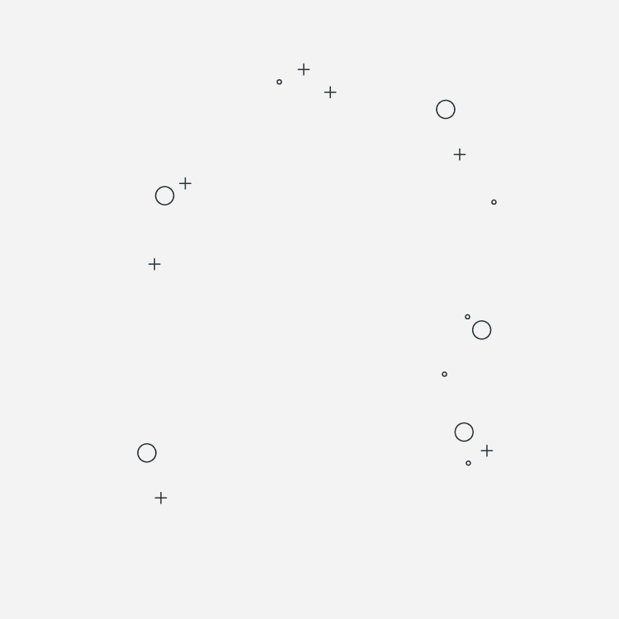
PBG Pacific Brands Ltd
Marketing Analytics PROJECT
A Story of SUE Morphet (PBG CEO)

Slide 2

Presented By:
S
Sukhman
A
Anna
This business case is about the underwear and apparel company Pacific Brands Limited (PBG) and the challenges facing its CEO Sue Morphet.
A
Aqeel
PBG Pacific Brands Ltd
A
Adeel

Slide 3

Short Story Journey Of SUE
What is this case about ?

Slide 4
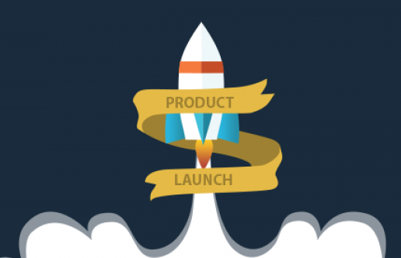
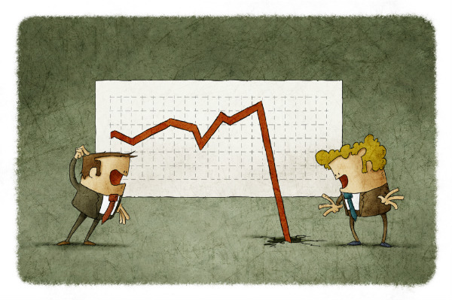

Pacific Brands Ltd
Pacific Brands is a major Australian underwear and hosiery manufacturer struggling with declining sales. The CEO wants to boost sales by promoting new bra lines to a consumer, but faces two different approaches from the CFO and CMO.
Disagreement between executives on a strategy
Need to promote new bra lines effectively amid economic downturn
Declining sales and profits

Slide 5


SUE MORPHET & Pacific Brands Ltd
Sue Morphet the CEO of Pacific Brands Limited (PBG), an Australian underwear and hosiery company. She just returned from a fashion week to her company headquarters.
Sue was worried about declining sales for PBG's new Infinity and Timeless bra lines. She had supported launching these fashionable bras targeting style-conscious women. However, the tough economy has reduced sales.

Slide 6
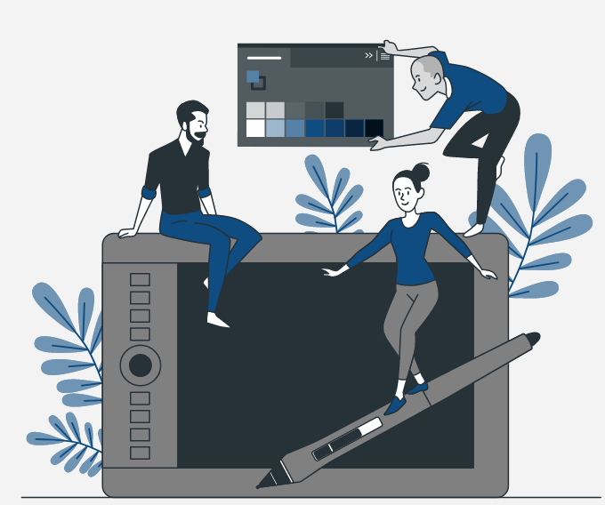
Sue's CMO, Mark:
I want to do market segmentation analysis to better target advertising
Kevin, the CFO:
This is a waste of money during tough times.
Sue knows she needs to get Mark and Kevin to collaborate. She reflects on an unsuccessful "Great Shape Bus" ad campaign that didn't drive sales

Slide 7


Why is this Significant ?
Sue realizes segmentation analysis could have prevented that campaign's failure.
She decides to get Mark and Kevin together, use data to show segmentation's value, and mediate a compromise between them.

Slide 8

COLLABORATION OF CMO AND CFO
Sue wants to save the new bra lines through smart, analytics-driven marketing.
She aims to leverage the expertise of both her CMO and CFO to make data-driven decisions on market segmentation and campaigns.

Slide 9

COLLABORATION OF CMO AND CFO
Sue seeks the following:
-to resolve a disagreement between her top managers,
-save declining sales of new products
-reshape marketing strategy
- all through promoting collaboration and data-driven decision making.

Slide 10
1. Disappointing Sales
01. Segmentation
2. Management Conflict
2. Analysis
3. Competition & Tough market conditions
3. Metrics
Decision Problems Marketing Analytics Opportunity
Analytics can identify the most attractive segments based on market potential and revenue forecasts
Metrics can be developed to measure and track ROI of campaigns for each segment.

Slide 11
—Case Question 1
Key segments of brassiere shoppers, according to differences in consumers’ physical, psychological, and retail experience needs?

Slide 12
—Key Segments
Physical Needs
Fit: Shoppers who consider how the bras fit in various situations.
Cut: pay attention to the bra cut.
Seam: consider the position of seams on bras.
Shape on Hanger and Shape on Body: concerned about the shape of bras on hangers and on their bodies.
Colors: interested in the colors available in bras.
Match: look for matching lingerie.
Psychological Needs
Fashion: conscious of bras as fashion objects.
Perception: believe that the clothes they wear influence how others think of them.
Brand for self and Brand for else: consider brand names when purchasing bras for themselves and others.
Popular: willing to pay a higher price for bras from popular designers or manufacturers.
First to Try, Fashionista, Ppl Ask Me, Fashion Magazine, No Big Deal, Not Bold: Descriptor variables related to shoppers' fashion consciousness, boldness, and preferences.

Slide 13
—Key Segments
Retail Experience Needs
Convenience: prefer buying lingerie at the most convenient store.
Shop Time: choose stores that reduce their shopping time.
Retail Experience: assess the overall process when buying bras.
Knowledge Staff: value the knowledge of sales staff about bras.
Store Display: pay attention to store displays.
Sales Staff: influenced by the advice provided by sales assistants.
Catalog and Web: use catalogues and the internet as sources of information for purchase decisions.

Slide 14
—Case Question 2
Does it make sense for PBG to target specific segments to increase sales for Timeless and Infinity?
If so, summarize the strategic rationale for the segmentation strategy and specify the segments that PBG should target. If not, explain why not.

Slide 15
Yes!
It makes sense for PBG to target specific segments to increase sales for Timeless and Infinity. The strategic rationale is
01
02
03
Branding & Positioning
PBG can tailor branding and positioning for each product line and audience.
Distinct value propositions
Infinity and Timeless have distinct value propositions that appeal to different consumer segments
Resources
Resources can be allocated more efficiently by quantifying segment opportunities and avoiding waste.
06

Slide 16
About Infinity and Timeless
Both have style and variety which is an important factor. Both target female consumers seeking a high-end product
01
01
02
Infinity
Timeless
Fashion forward younger women who want stylish and trendy bras.
More brand conscious and willing to pay higher price
Tech-savvy segment responsive to social media campaigns and fashion magazines
Cares about how the bra fit the event
Positioned as a modern, stylish and fun line for younger women
Convenience seeking middle-aged women who are young at heart and want to feel sportier and younger
﻿Less brand conscious and moderately price sensitive
Seeks quality and comfort. Fits into easier shopping style as they seek for convenient shopping
Cares more about how their look impact the way people think of them
﻿Positioned as a practical yet feminine line for middle-aged, active women for everyday use

Slide 17
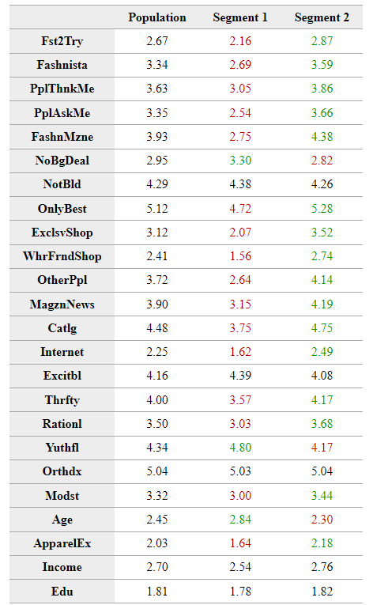
Segment 1 - Price Sensitive Segment
Deal and promotion focused
Seek low prices over factors like fashion or brand
Shop primarily discount and budget retailers
Less likely targets Infinity and Timeless
Segment 2 - Fashion/Style Focused Segment
Willing to pay more for style, fashion and brand
Influenced by magazines and social media
Shops department stores and specialty boutiques
Strong potential targets for Infinity and Timeless
— 2 Key Segments

Slide 18
Quantitative Measures
The Segment 2 holds 75% potential buyers. Price is not their main consideration while making a purchase.
75%
25%
Segment 2
Segment 1
Price
No Big Deal
Discounts
Age
Fashion
Only Best
Internet/Magazine
Income
PeopleThnkMe
Segment 1
Segment 2

Slide 19
—Case Question 3
What specific advertising and retailing programs would allow the company’s new offerings, Timeless and Infinity, to target their potential respective buyers most effectively?

Slide 20
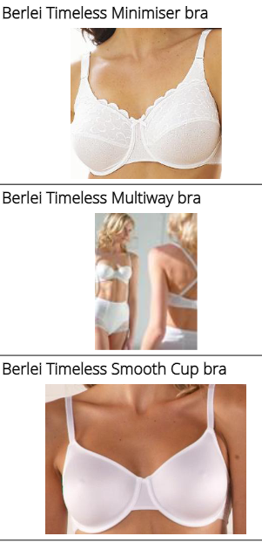
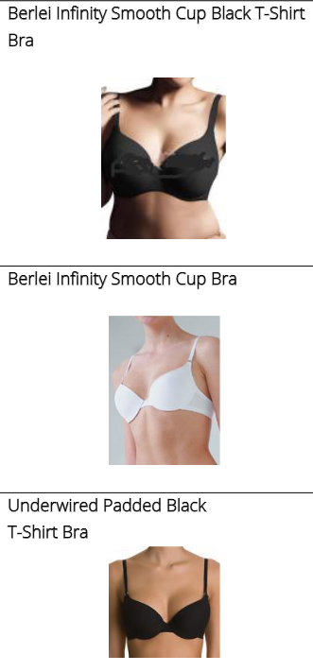
Advertising and Retailing Programs
Understand the audience and communicate the brand uniqueness. Specific programs to effectively target potential consumers for Timeless and Infinity
Infinity
Timeless
Advertising in home & lifestyle magazines focusing on quality over trends Catalogs/mailers with customer testimonials about comfort and fit
Advertising in fashion magazines/blogs showcasing bold trends Instagram/influencer campaigns modeling the bras in eye catching outfits

Slide 21

Advertising and Retailing Programs
Specific programs to effectively target potential consumers for Timeless and Infinity
Infinity
Timeless
In-store displays that are readily available, established brands In-store fit specialists to assist with bra selection and perfect fit and comfort or a loyalty program
Pop-up events in reputed locations or fashion shows Boutique store displays. Signage highlighting technical innovations and fashionable details

Slide 22

—Case Question 4
Based on your analysis, develop a strategy brief for Sue Morphet, explaining how she should address the concerns of her CFO and CMO.

Slide 23


CFO & CMO CONCERNS
Challenger
Economic downturn and decrease in customer expenditure
Increasing global competition and growing presence of private labels
CMO’s Concerns
Leveraging Proper Segmentation for Targeted Customer Engagement and Strategy Optimization
Diversified Marketing Approaches based on Customer Insights
Utilizing Numerical Analysis to Highlight Market Resilience & Growth Potential During Economic Challenges
CFO’s Concerns
Tight economy - cut costs wherever possible
Wasting resources for marketing campaigns
Risk aversion – Failure of previous campaign

Slide 24
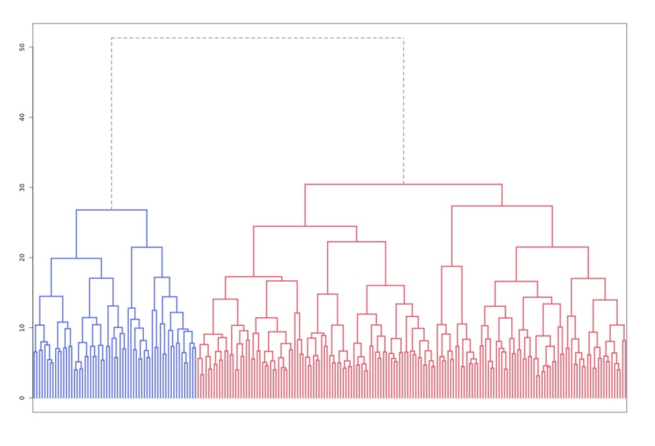
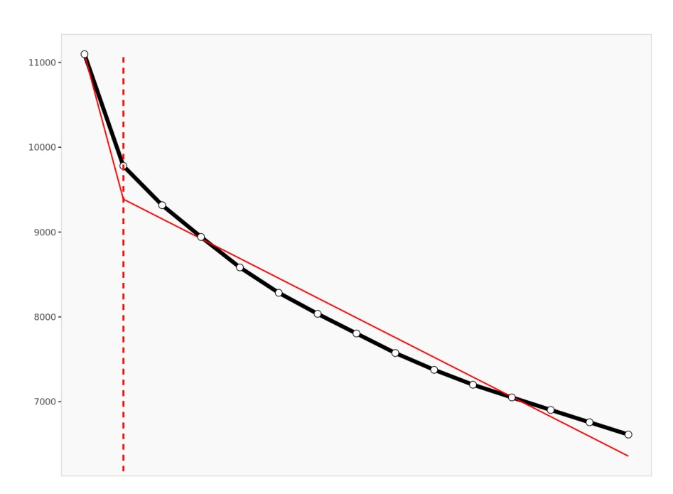
SUE Strategies
Sue Strategy
Quantitative Segmentation Analysis Meeting Plan
Learning from GSB Campaign Failure - Targeting Specific Segments, Not General Audiences
Empowering CFO in Resource Allocation
Showcasing Mark's Successful Online Business Strategy

Slide 25
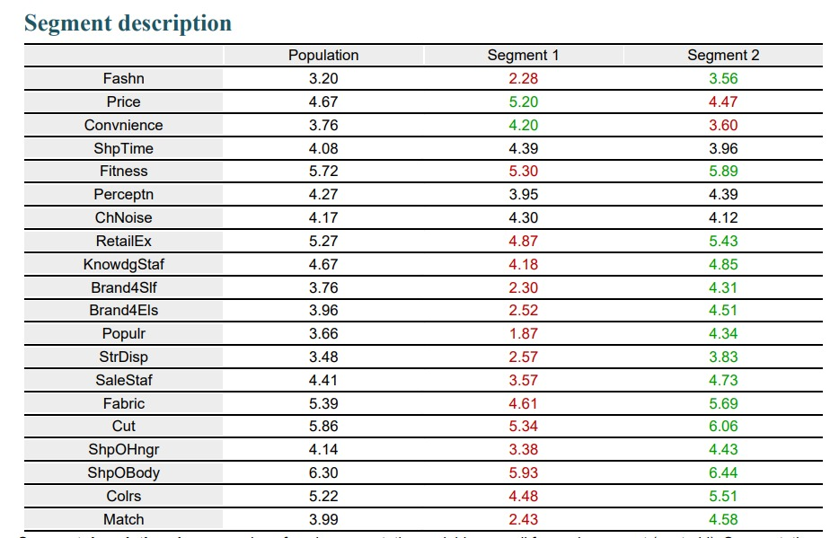
Segments

Slide 26
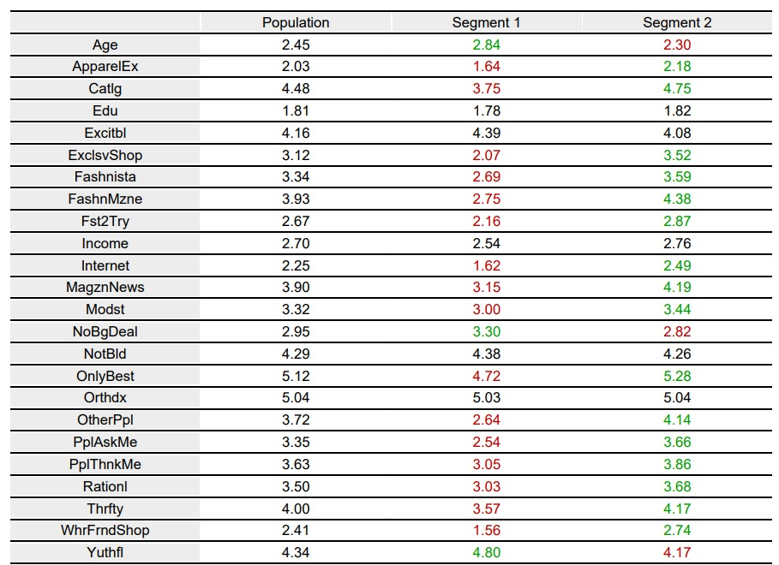
Descriptive
Variables

Slide 27




SWOT ANALYSIS
Established brand reputation and quality.
Detailed consumer segmentation insights
Strength
Economic sensitivity affecting consumer purchases.
Intense market competition.
Weaknes
Expansion potential in e-commerce.
Digital engagement with a younger audience.
Opportunities
Competitive price undercutting.
Consumer shift towards sustainable products
Threats

Slide 28
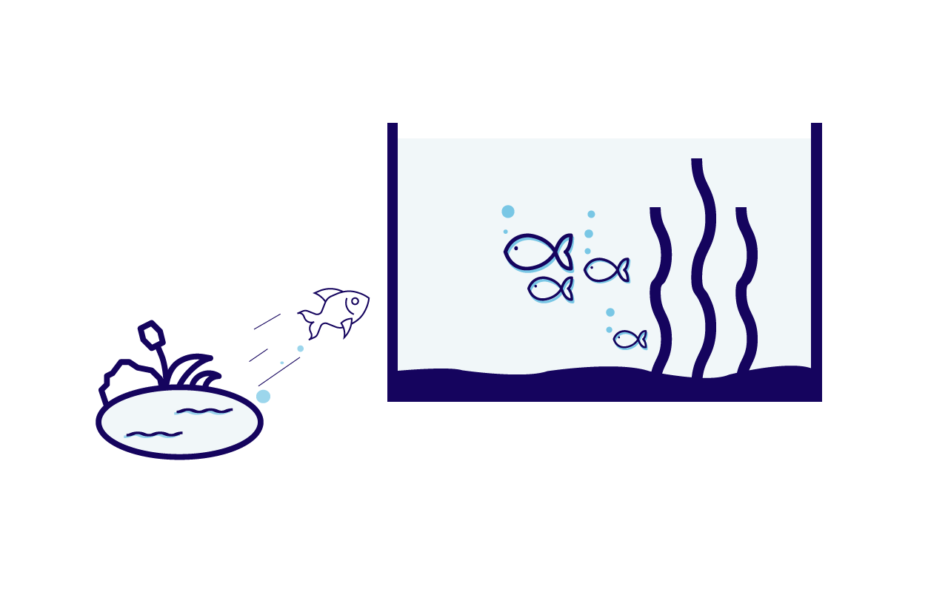

PORTER’s FIVE FORCES ANALYSIS
Threat of New Entrance
Bargaining Power of Suppliers:
Entry barriers exist but lowered by online marketplaces.
Limited due to various sourcing options.

Slide 29



PORTER’s FIVE FORCES ANALYSIS
Bargaining Power of Buyers
Threat of Substitutes
Industry Rivalry
Prevalent, with many alternative products.
Fierce, with continuous innovation and price competition.
Significant, with high expectations for value.

Slide 30
Sue’s Conclusion
Segmentation identifies distinct consumer needs and motivations, enabling more targeted marketing
Targeting Infinity to Fashion Leaders and Timeless to Quality Seekers will optimize appeal.
Marketing mix and messaging can be tailored efficiently without fragmentation.
Collaborate closely across teams when executing segmented marketing strategies.

Slide 31
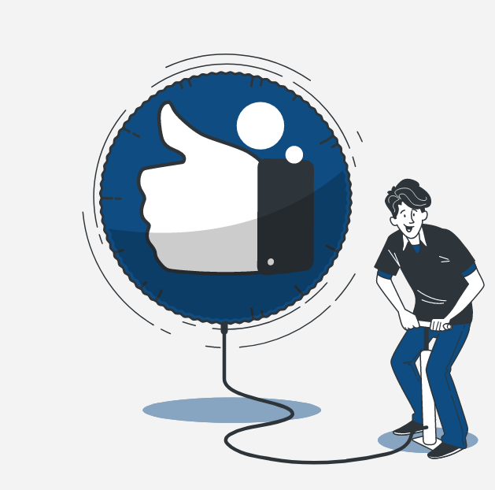
Any Question?

